Slide 1
MOC
Renewal Application
Upload License
Sonnya Dennis, DVM, DABVP (Canine and Feline)
ABVP Maintenance of Certification Committee Chair
Last update 4/1/23

Slide 2
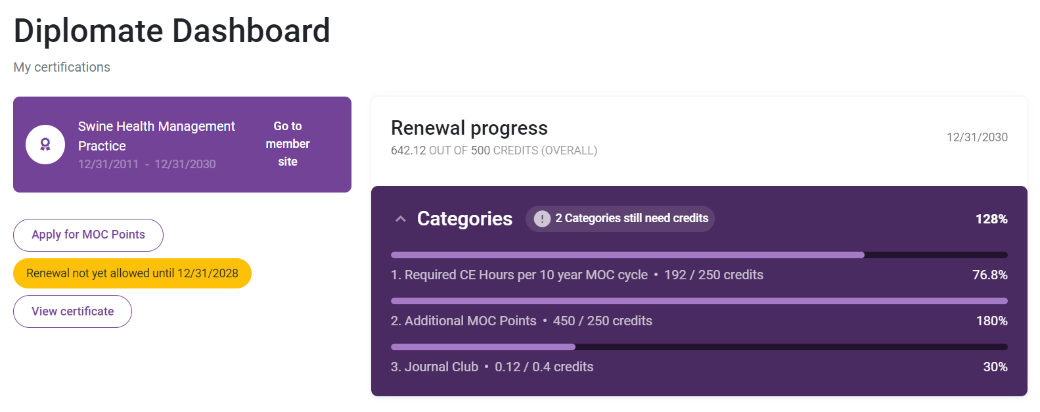
Not ready to renew.

Slide 3
Date, total points, category points

Slide 4
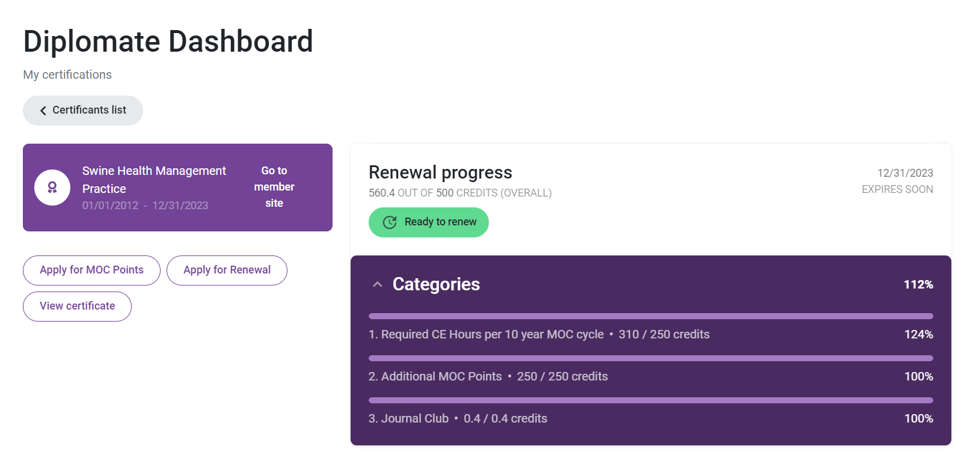
Ready to renew!

Slide 5
Ready to Renew
=
500 Total Points
Transition Points have already been applied, so just look at totals for each category.
Be sure all points bars are full.
VCs need time to review.
THEN, click RENEW!
250 Required CE Category
250 Additional Category
0.4 Journal Club

Slide 6
Click “Apply for Renewal” to start the final MOC application.

Slide 7
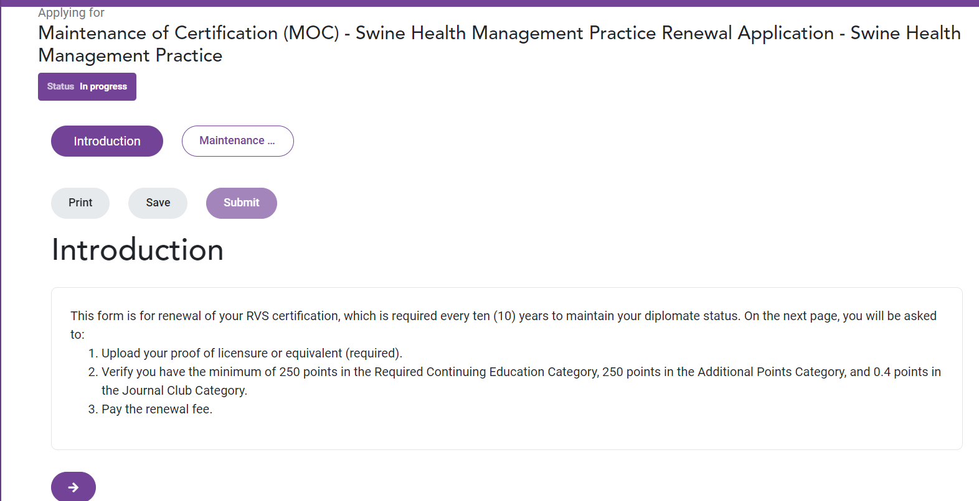
R.I.F.

Slide 8
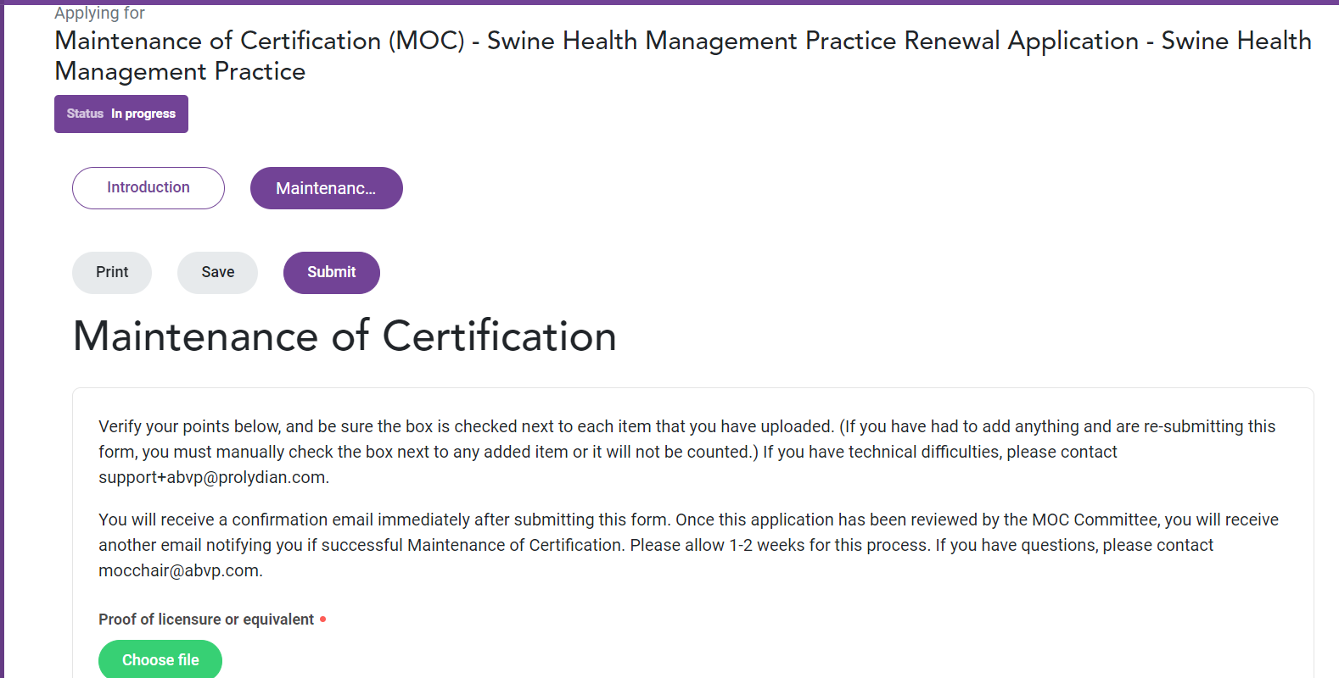
copy of licence (pdf, jpeg, etc)

Slide 9
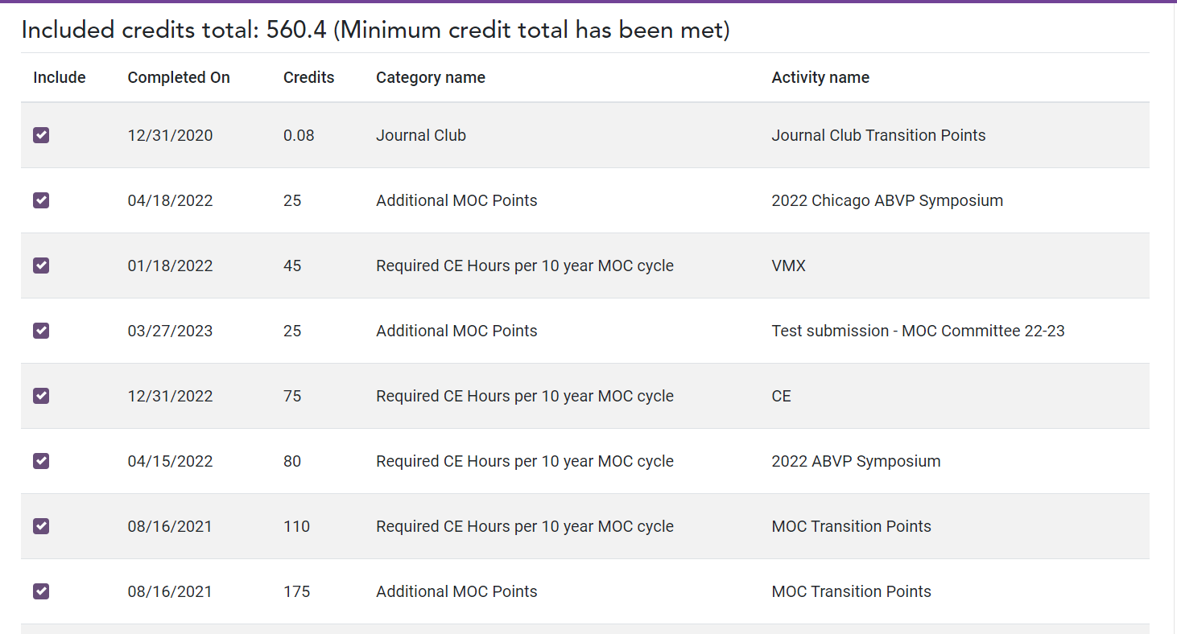
Scroll down to see list of all your points.

Slide 10
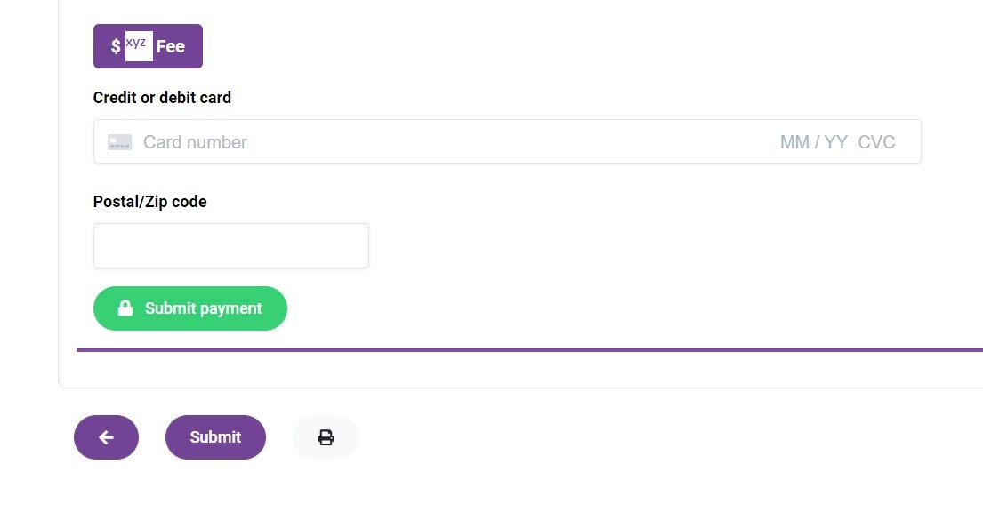

Slide 11
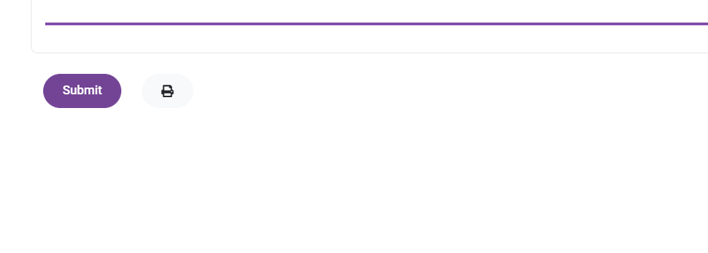
Don’t forget to click “Submit”

Slide 12
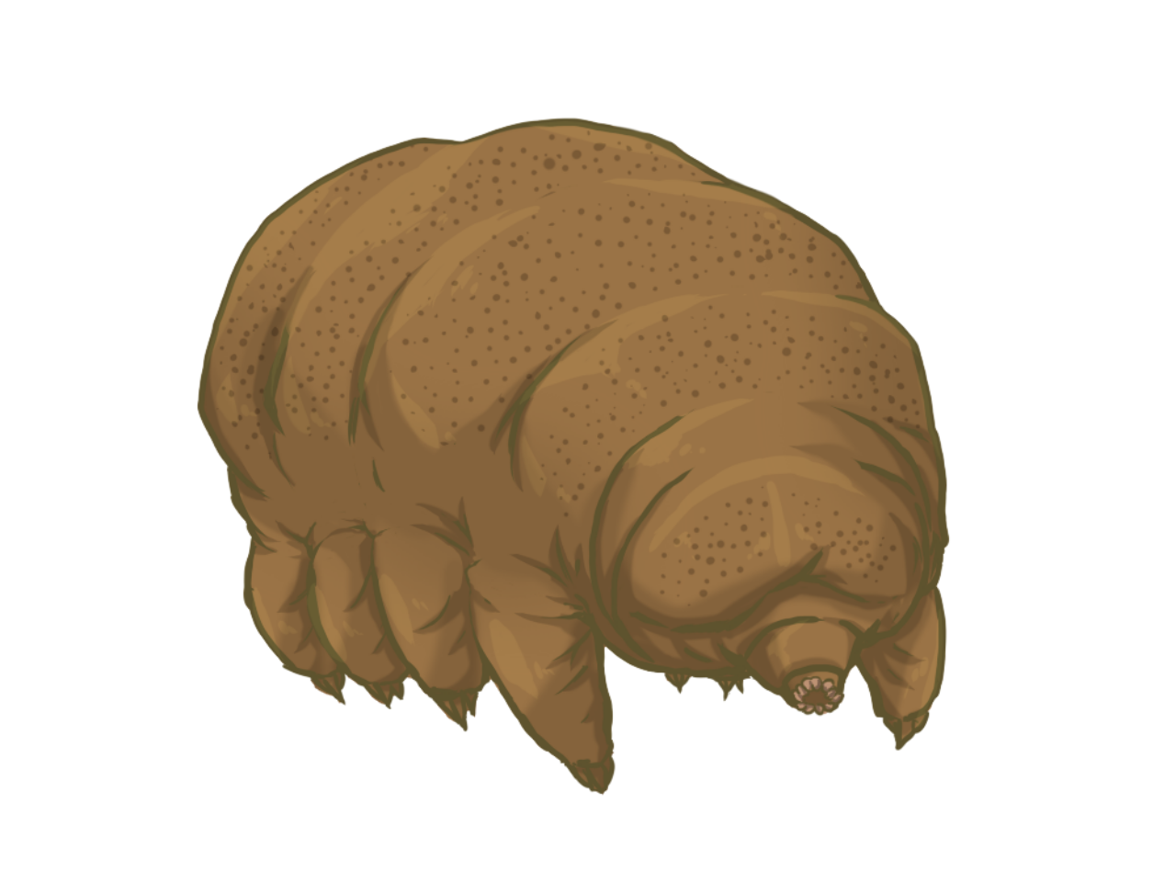
After submitting, the MOC Chair will review the final application and verify all requirements have been met.
Once this is complete, you will receive an email that you have completed your Maintenance of Certification!

Slide 13
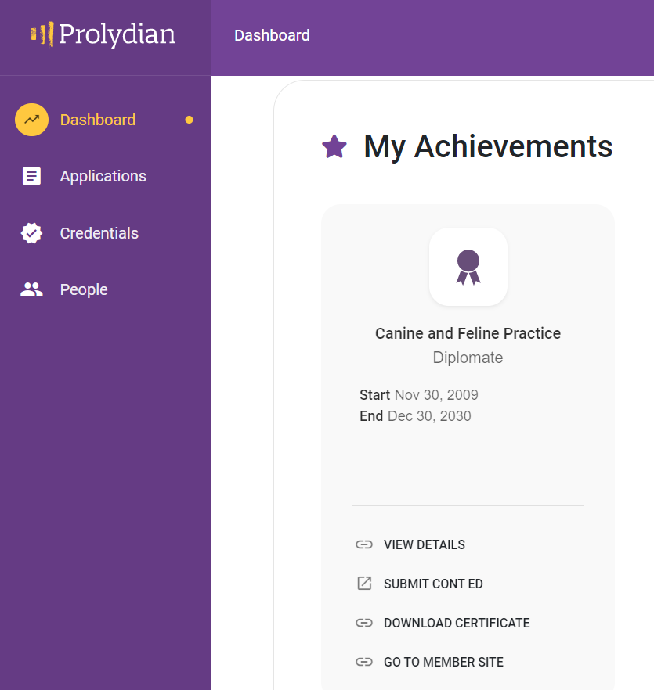
Done!
Ready to start again!

Slide 14
Maintenance of Certification
Committee 2023-2024
Sonnya Dennis, Chair mocchair@abvp.com
Anthony Pilny, Avian avianmoc@abvp.com
JoLynn Grant (A-L) & Ellen Olson (M-Z), Canine/Feline caninefelinemoc@abvp.com
Amy Santonastaso, Equine equinemoc@abvp.com
Hilary Stern, Exotic Companion Animal ecmmoc@abvp.com
Rachel Seder, Feline felinemoc@abvp.com
Dan Posey, Food, Beef, and Dairy foodbeefdairymoc@abvp.com
Heather Bjornebo, Reptile/Amphibian ramoc@abvp.com
Uri Donnett, Shelter sheltermoc@abvp.com
Lisa Tokach, Swine swinemoc@abvp.com

