Slide 1
How to Apply for MOC Points
Sonnya Dennis, DVM, DABVP (Canine and Feline)
ABVP Maintenance of Certification Committee Chair

Slide 2
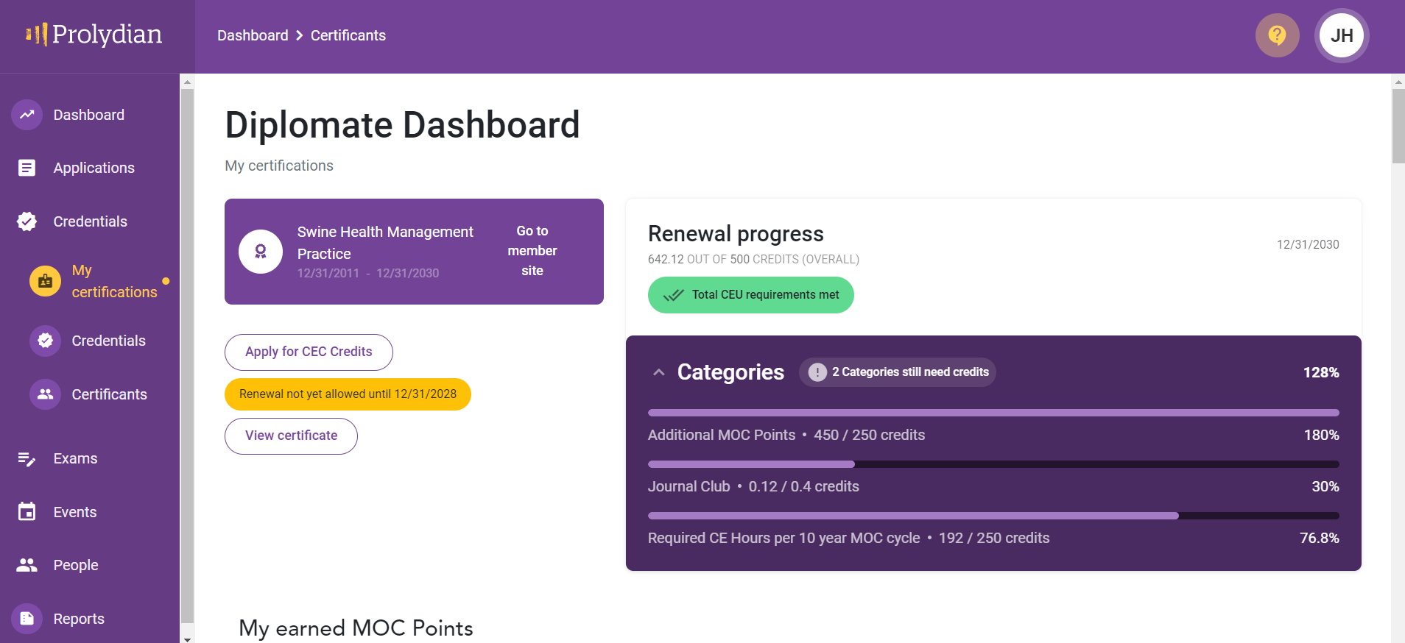
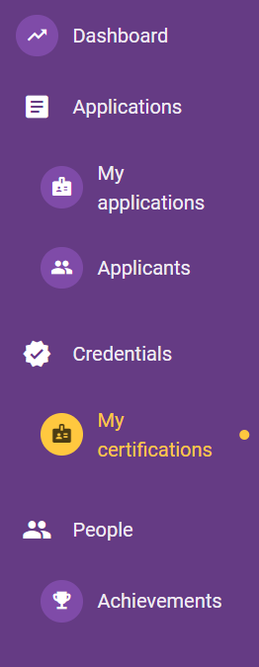
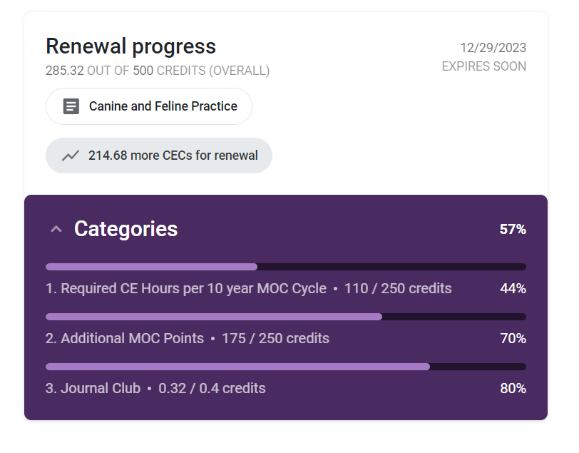
Start an application
CEC Credits
=
MOC Points

Slide 3
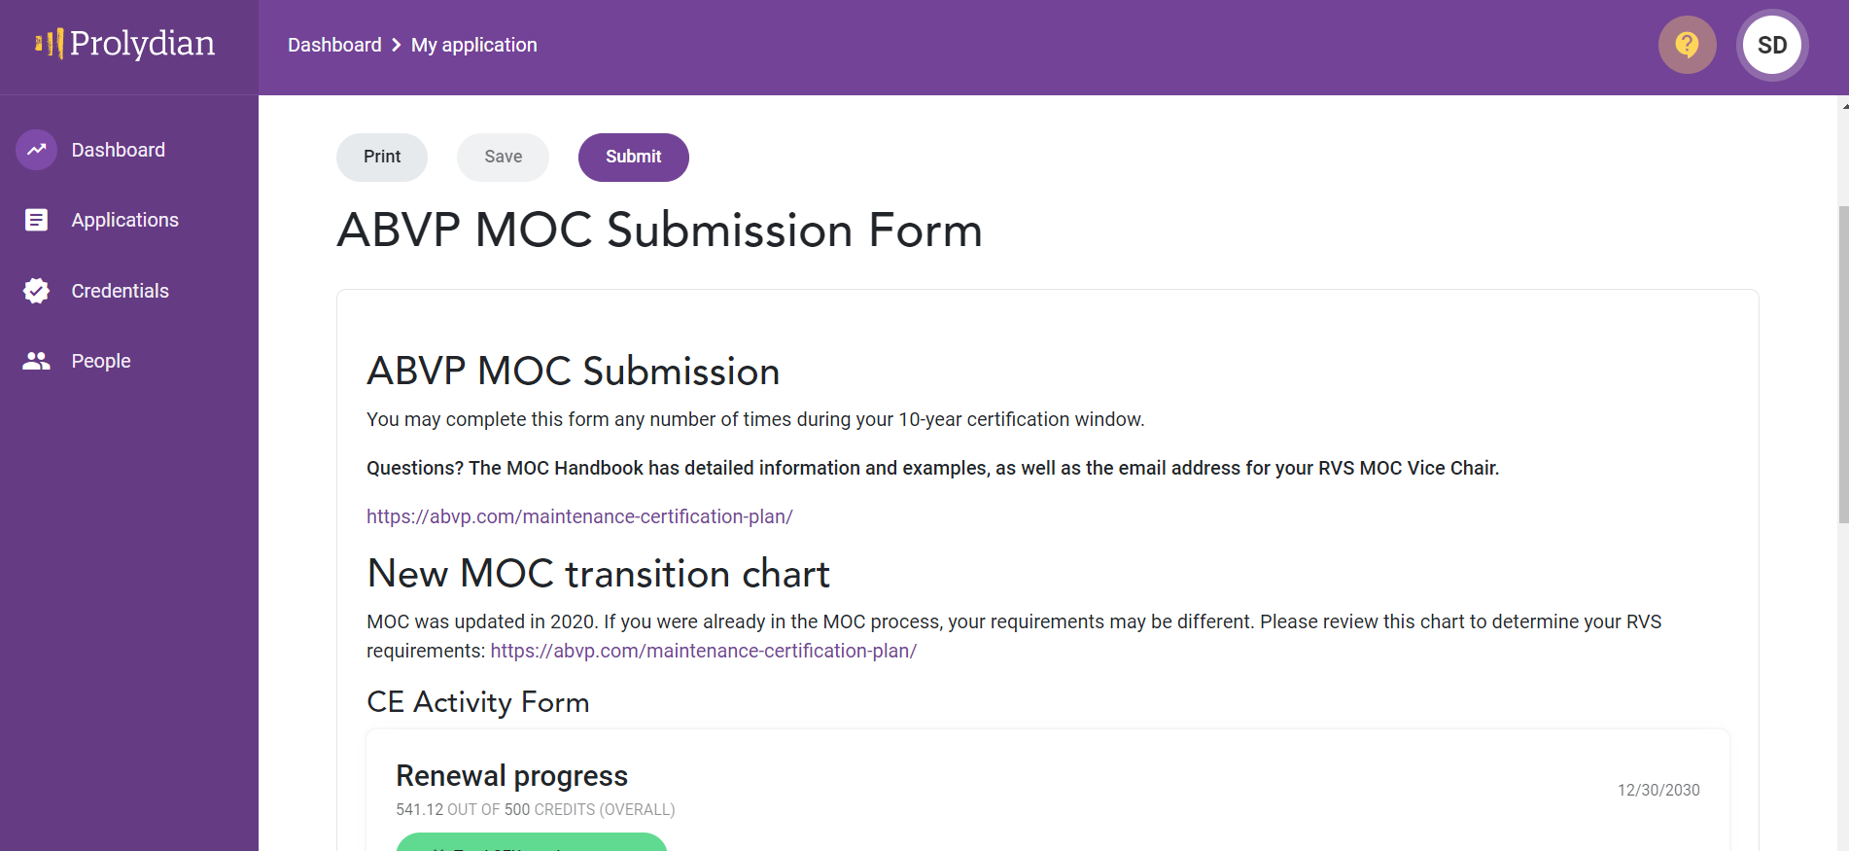
It will look like this.

Slide 4
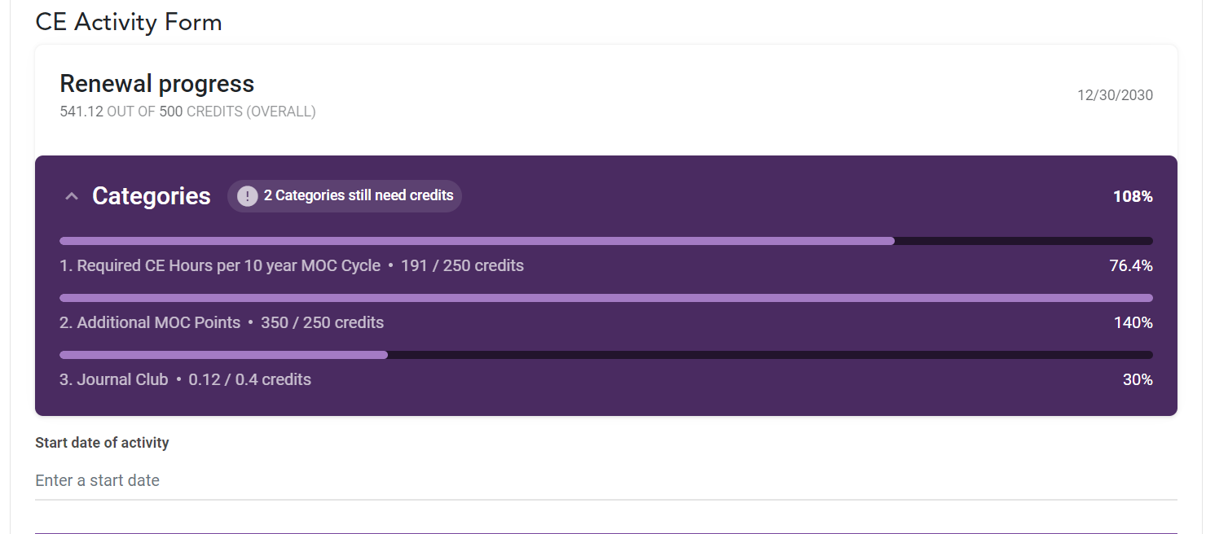
Scroll down
You will see
a summary of
3 Categories
Enter date.

Slide 5
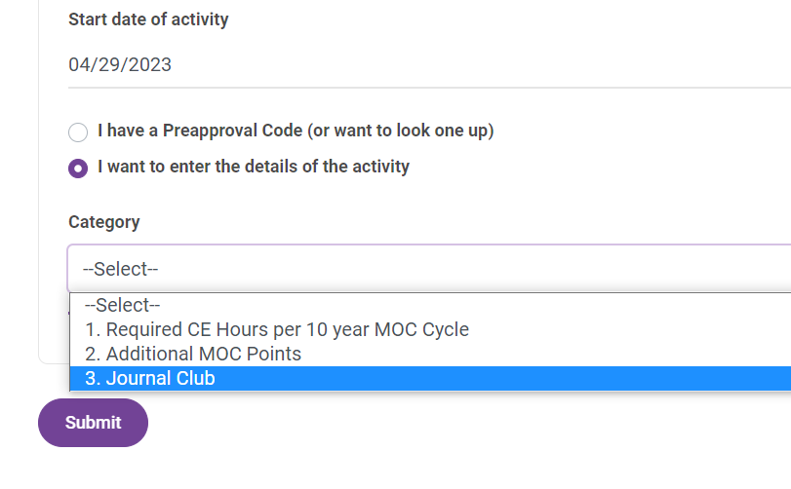
Scroll down
3 Categories
Required CE
Additional Points
Journal Club

Slide 6
Required CE

Slide 7
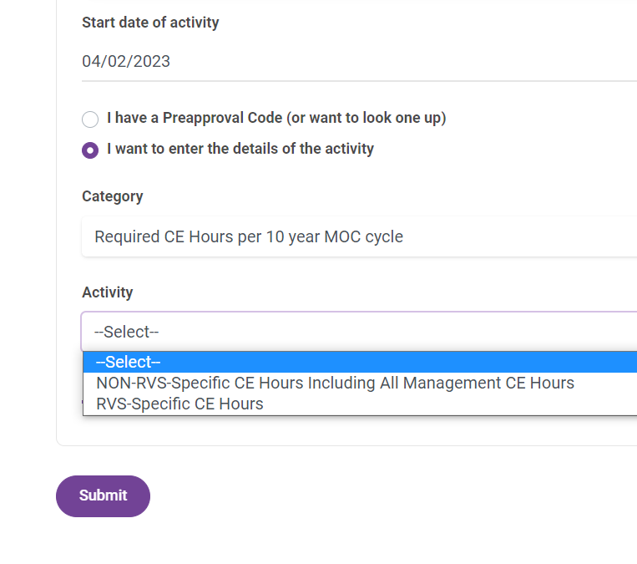
CE
Choose Activity:
NON-RVS
or
RVS

Slide 8
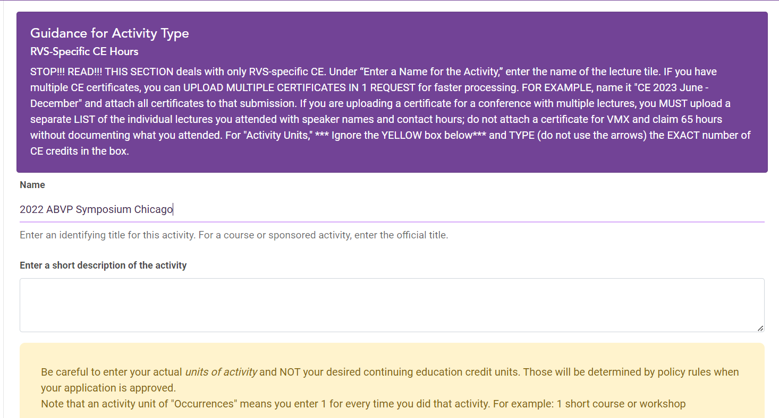
Name
READ the Purple Box!!!
Something sensible so you know what you uploaded.
(We have no control over the yellow box.)

Slide 9
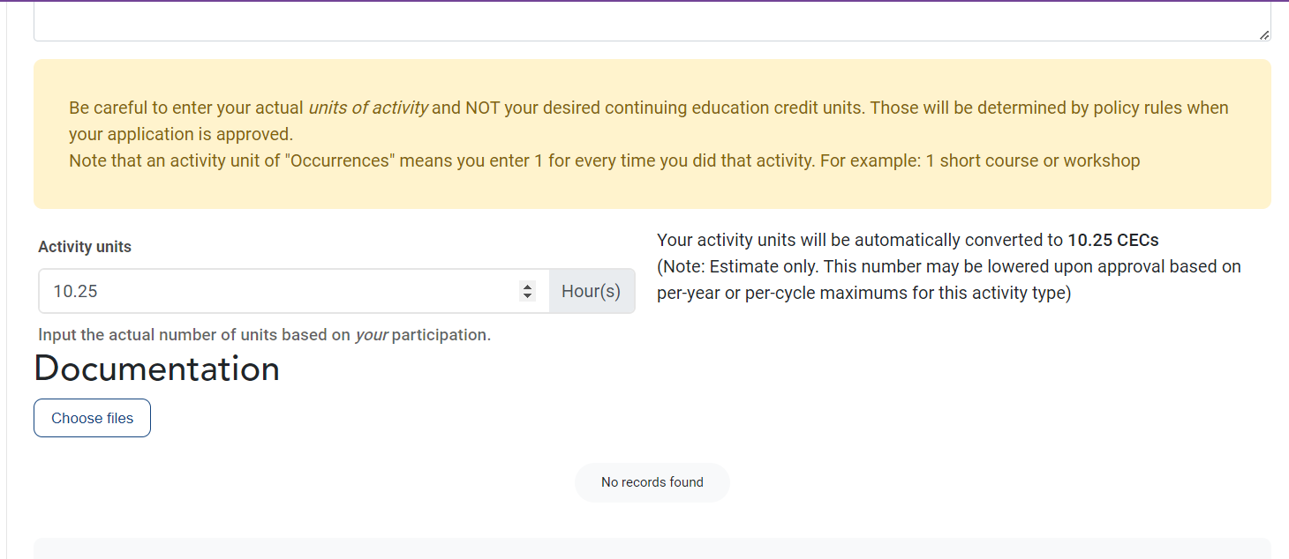
Activity Units (are just CE Hours
Ignore the yellow box.
Type, do not use up/down arrows.

Slide 10
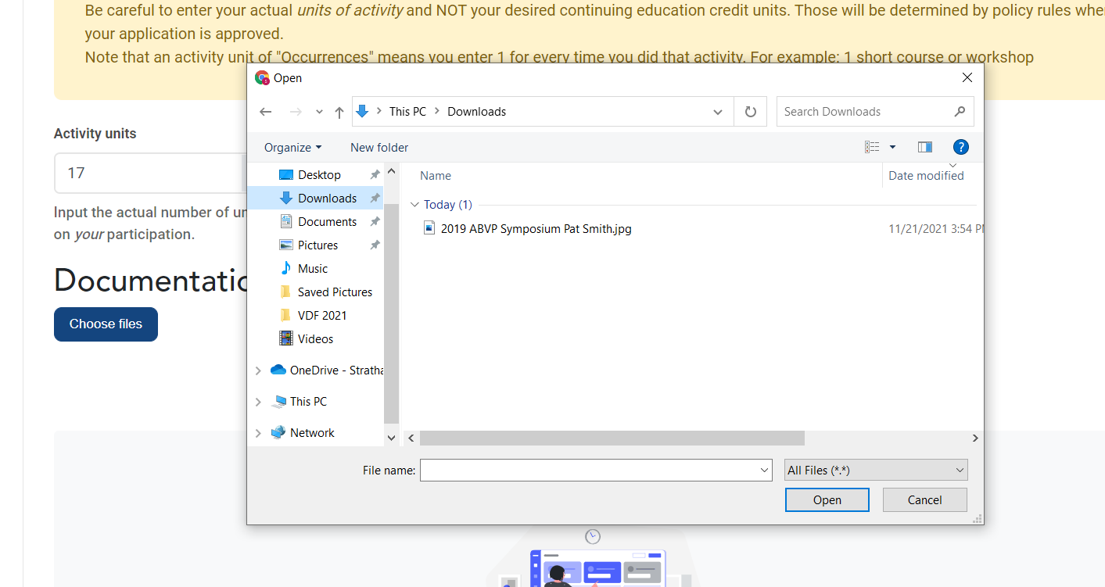
Choose file
Prefer jpeg or pdf
NO HTML or Apple proprietary files!!!
See MOC webpage for how to screenshot

Slide 11
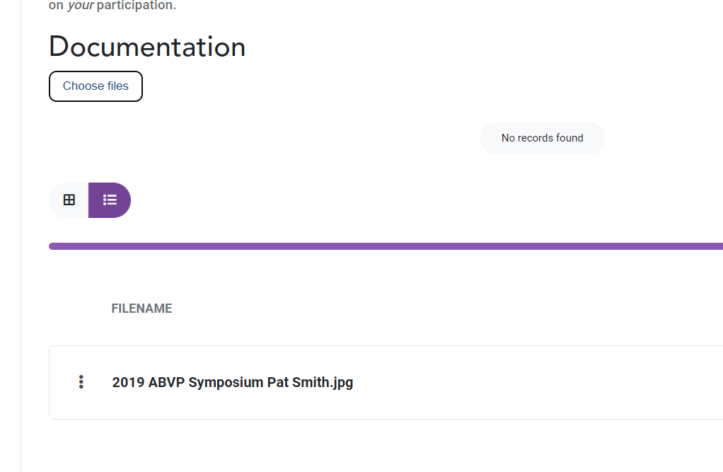

Slide 12
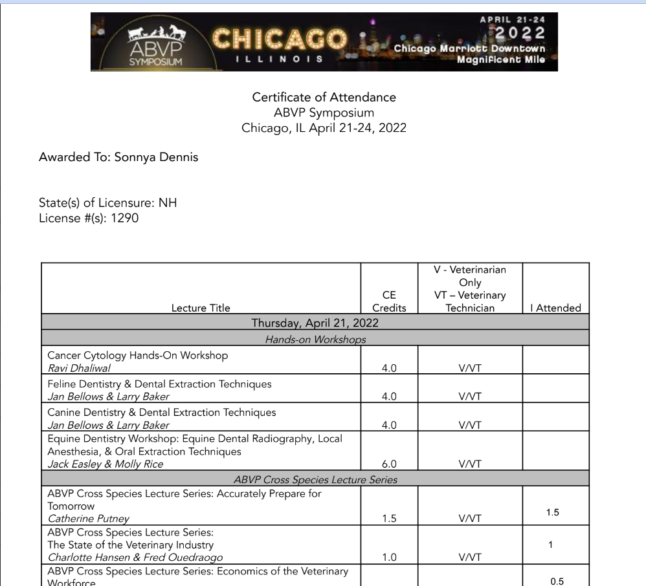
also
If a symposium or large conference, include a list of lectures.
Do NOT just attach a VMX certificate and request 45 CE hours.

Slide 13
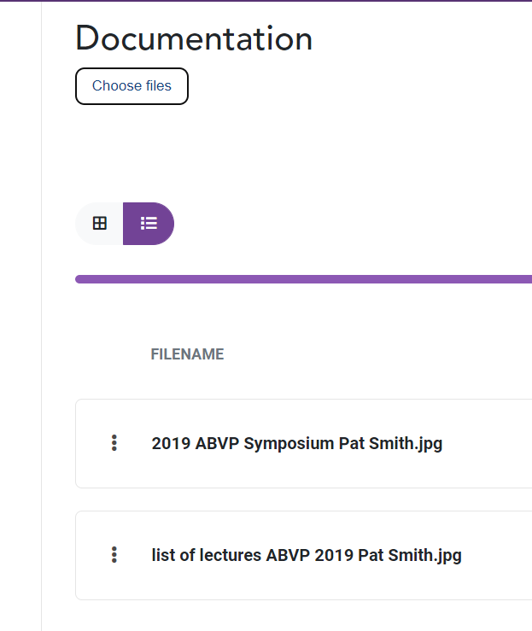
Multiple attachments
Tips:
Multiple 1 pointer CE lectures over several months
Big Symposium
Wet Labs
Name for example, “2021 Jan-Jun VetGirl .”
If 5 hours of CE, enter “5” for quantity of total CE hours.
Then attach each of your 5 CE certificates.

Slide 14
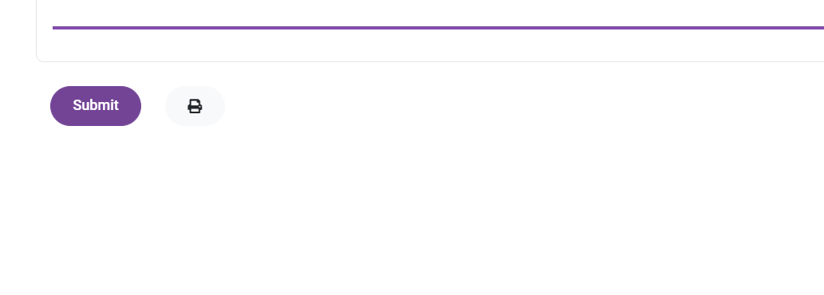
Submit
Don’t forget to click “Submit”

Slide 15
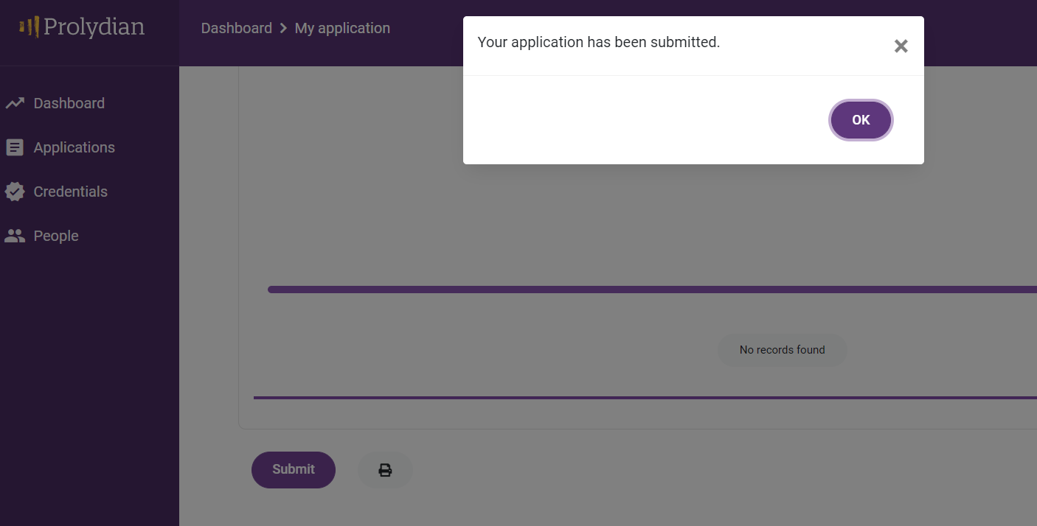
Done.
You will get a pop-up that it has been submitted and an email notification.
If you are NOT getting emails, contact Prolydian, not ABVP.

Slide 16
Confirmation email

Slide 17
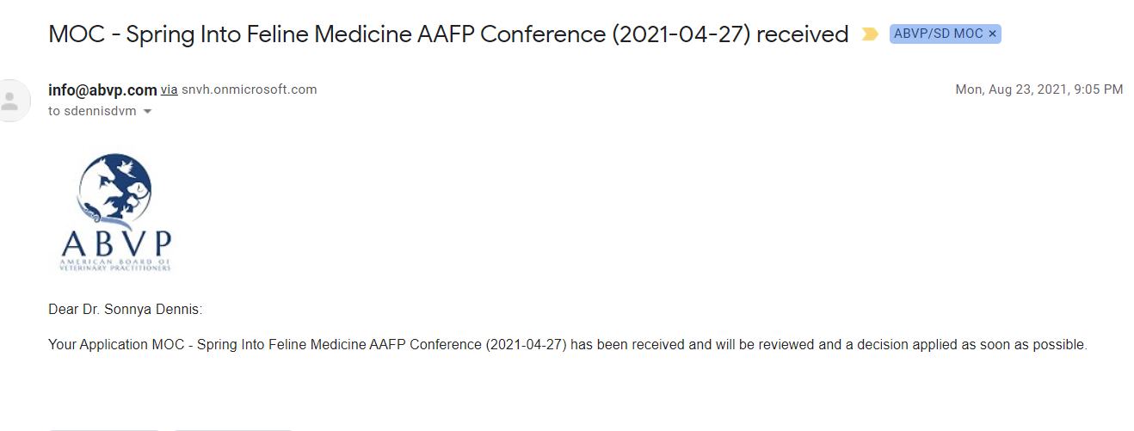
LOOK for your Confirmation of Receipt

Slide 18
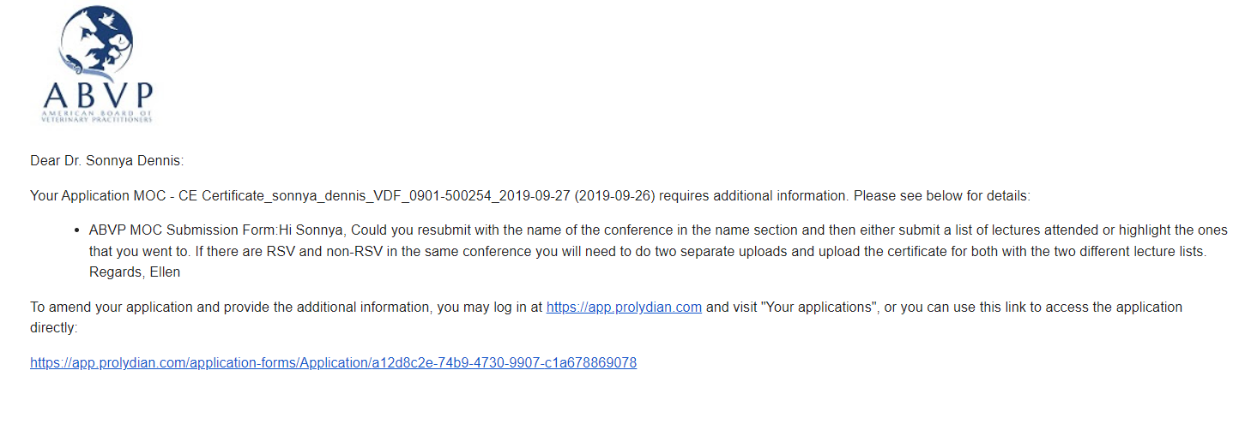
Check your email: APPROVAL, NEEDS INFORMATION, OR REJECTION

Slide 19
Journal Club

Slide 20
A little weird
1 JC = 0.01 points
Minimum of 4 per year X 10 years
= 0.4 points

Slide 21
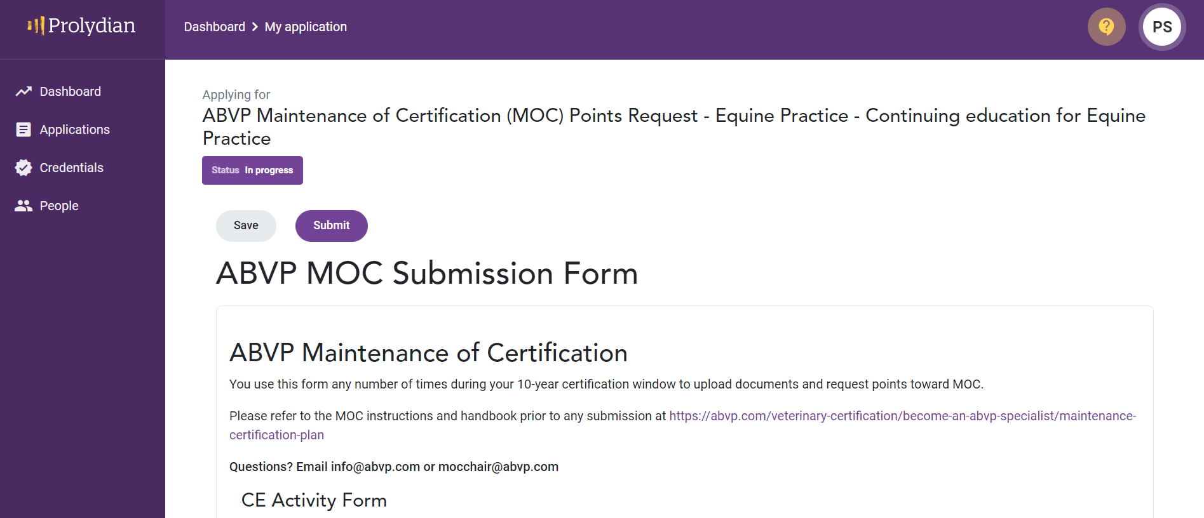
Journal Club
They all start with “continuing education…don’t let it confuse you.

Slide 22
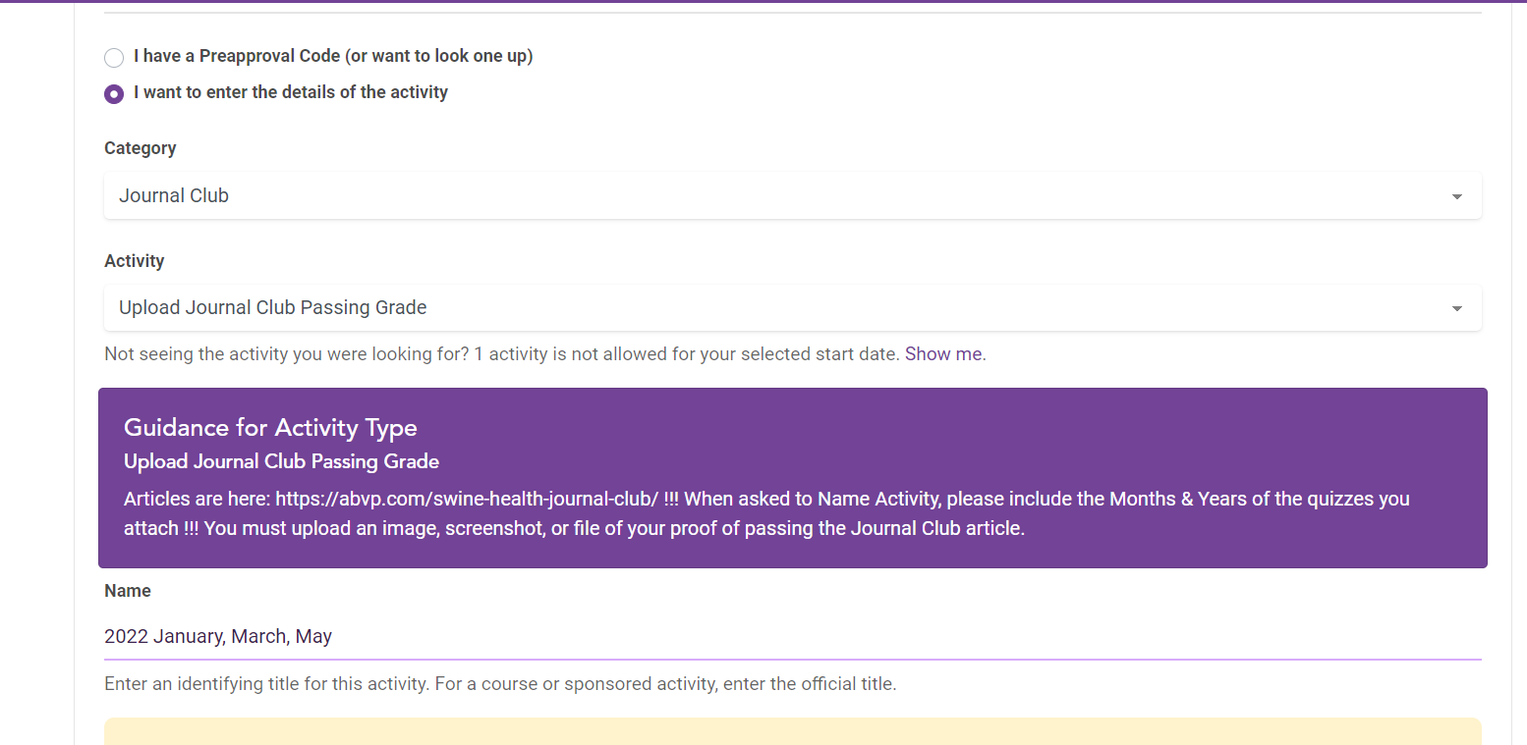
Scroll down
Enter just like before.
Year & Month

Slide 23
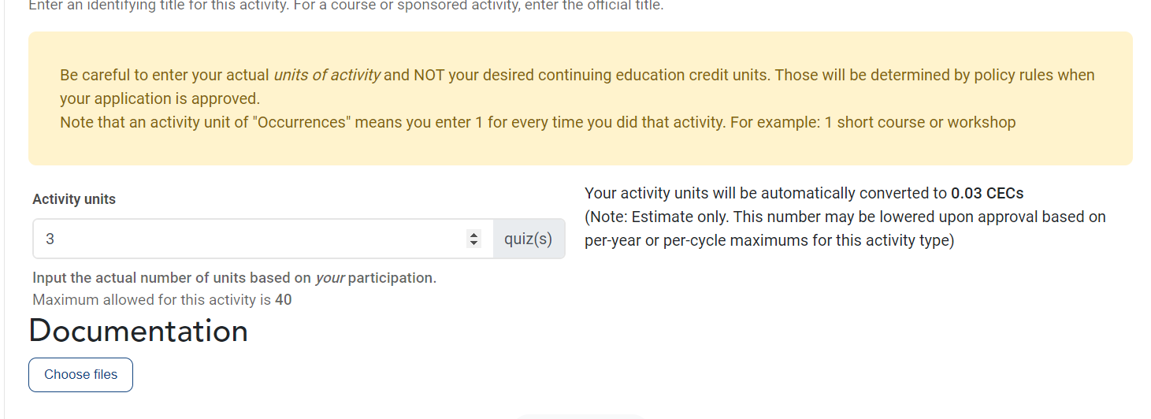
Scroll down
Ignore yellow box!
1 JC = 0.01 points

Slide 24
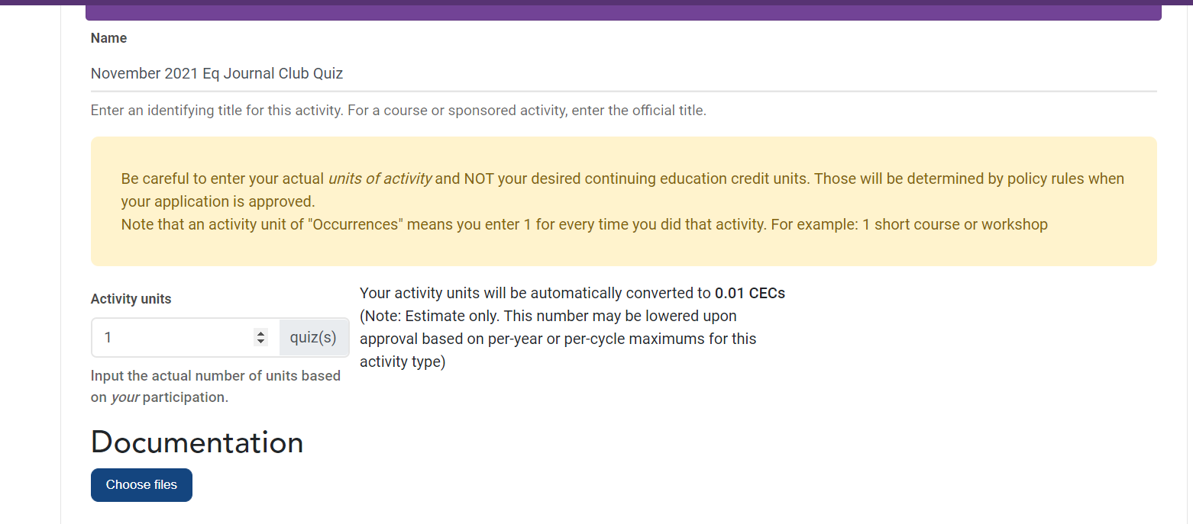
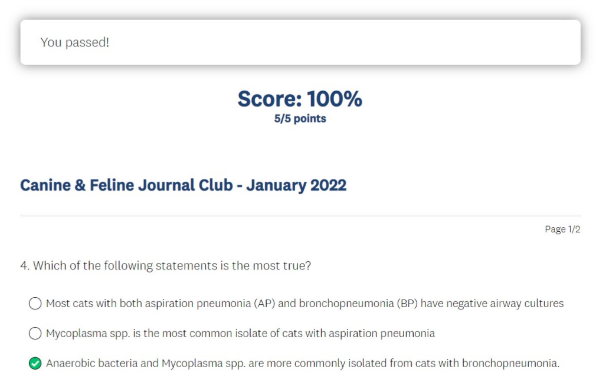
Remember to screenshot!

Slide 25
Apply for Additional Points

Slide 26
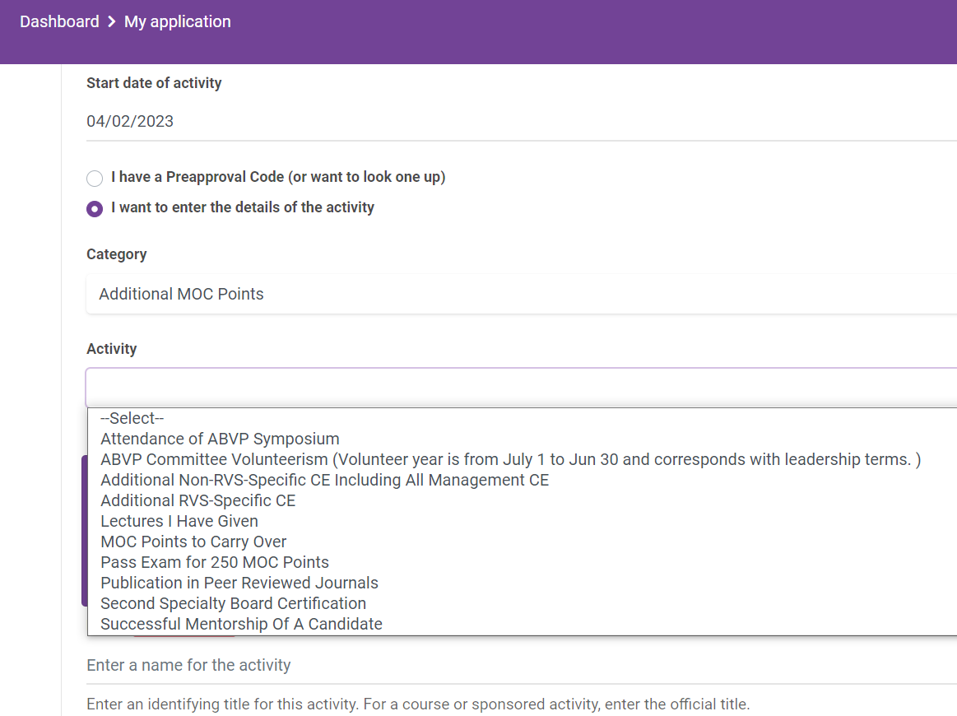
Additional Points
3 Categories
We covered
Required CE
Journal Club
now
Additional Points

Slide 27
Additional Points
Multiple Activity Options!
Attend ABVP Symposium
Volunteer on Committees
Additional CE RVS
Additional CE NON-RVS
Give Lectures
Carry over MOC Points
Pass the Exam
Publish
Second Specialty
Successful Mentorship
Read the details in the handbook!

Slide 28
ABVP Volunteerism
You may earn 25 points per committee per year for active service in an official ABVP committee or position.
Duties may vary and will be established by the committee chair or vice chair.
Complete this form https://forms.gle/yvqSQoQ4PANSTGqg8 if you are interested in volunteering.
All Committee Chairs are responsible for submitting a list of the names and emails of their volunteers to the MOC Chair annually for point credit. The list is due June 30 for the preceding volunteer year.
The volunteer year is from July 1 of one year to June 30 of the following year. Diplomates who have volunteered will receive an email, from the MOC Chair, once all the Committee Chairs submit the lists at the end of the volunteer year.
Point requests may be submitted in Prolydian by the diplomate once the diplomate receives confirmation of participation (attach a screenshot of the email from the MOC Chair). They will be verified with the MOC Committee (Vice) Chairs for membership and contribution to a standing committee.

Slide 29
ABVP Symposium attendance
25 Points per year.
These points are in addition to any points submitted for actual lectures attended.
Upload the certificate.

Slide 30
Publication in peer reviewed journals
25 points per publication.
Guidelines are acceptable if published in a peer reviewed journal and in your RVS.
First authorship is not required.
Letters to the editor are not acceptable.
Book chapters are not acceptable.

Slide 31
Lectures
25 points per year. 1 Lecture = 25 points.
Given to veterinarians/veterinary students or veterinary technicians/technician students
Lectures to non-medical audiences such as breeders, farriers, etc., are not acceptable.
Lectures must be in your RVS.
Documentation of the lecture must be uploaded
Certificate from organizing body, official class syllabus, etc.
Do not upload PowerPoints.
The same lecture may not be submitted every year for 10 years, but new lectures or substantially different lectures, may be submitted in subsequent years for a total of 250 points over a 10 year period.

Slide 32
CE over the required 250 points
2 MOC points per hour.
There is no limit to additional hours submitted.
Extra hours can be in any RVS.
Upload documentation as described previously in this document.

Slide 33
Successfully mentored ABVP applicant:
125 points.
The ABVP encourages mentoring of those going through the certification process.
For the diplomate to obtain volunteer points for mentoring, the mentee (after successfully passing the exam and becoming a diplomate) must fill out this form: Identify My Mentor. Contact info@abvp.com or MOCchair@abvp.com with any questions.
The mentee can only identify one diplomate as their mentor. Points cannot be split between more than one (1) mentor.
Once the mentee (new diplomate) identifies their mentor, the mentor will receive an email to upload to Prolydian as verification.

Slide 34
Second specialty board certification
75 points.
This applies only to new board certification.
Specialty boards are those recognized by the AVMA.

Slide 35
Passing the exam
In year 8, 9, or 10: 250 points.
Diplomates CANNOT MOC by exam only! Passing the exam in one of these years ONLY provides points.
The other requirements MUST still be met to MOC by points
continuing education
journal club

Slide 36
MOC
Next: the renewal application

