Slide 1
MOC Handbook
Prolydian Mechanics
(If you have not already reviewed the presentation on the handbook and rules,
do that first.)
Sonnya Dennis, DVM, DABVP (Canine and Feline)
ABVP Maintenance of Certification Committee Chair
Last update 4/1/23

Slide 2
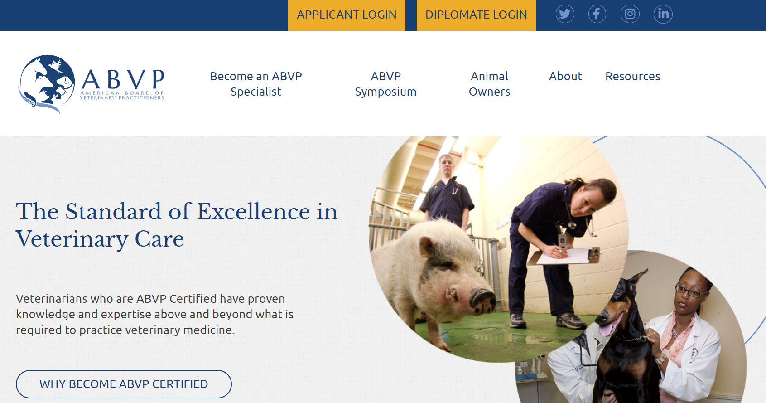
Start at ABVP.com

Slide 3
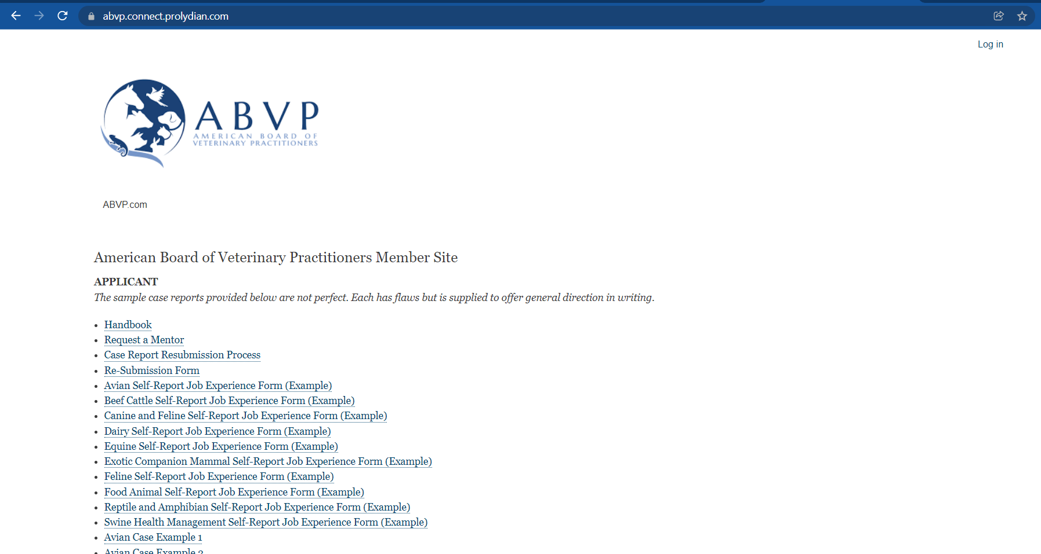
Member Portal Log in is in the upper right corner.

Slide 4
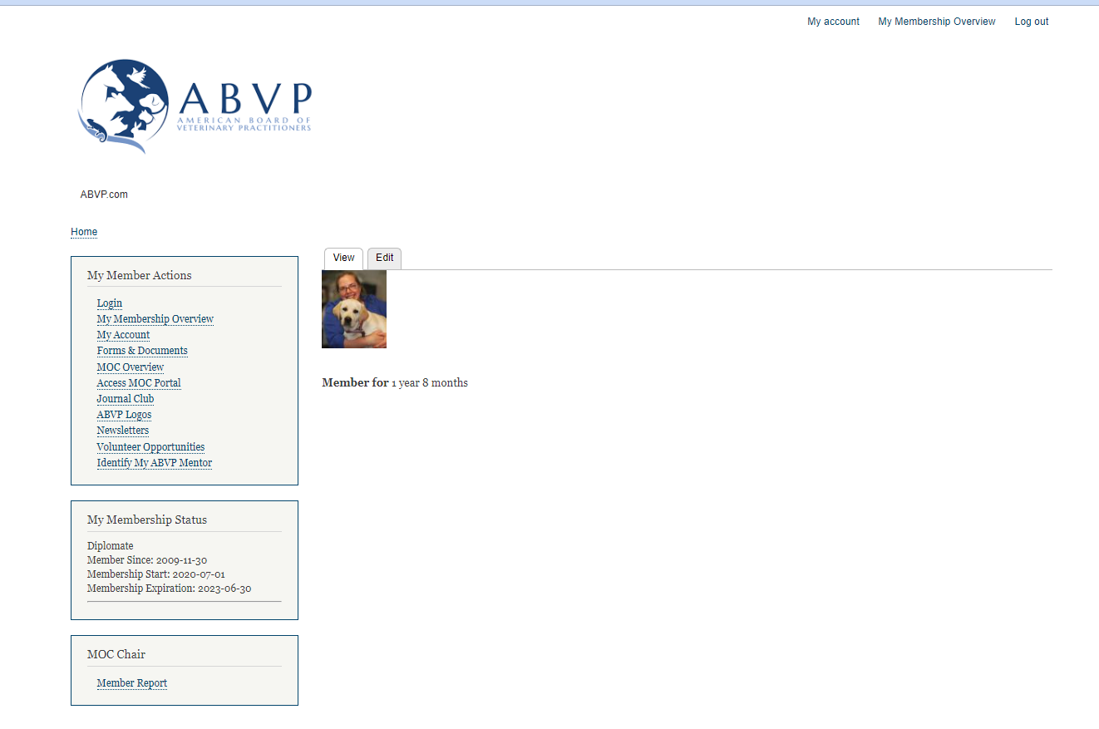
My Account
If it does not look like this, you are not logged in.
This is your DIPLOMATE PORTAL - Quick Detour due to frequently asked questions.
Click “My Account” in the upper right.

Slide 5
My Account
Click on “Edit” to update your email address.

Slide 6
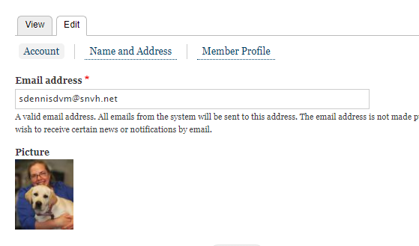
My Account
Click on “Edit” to update your email address.
This keeps your Diplomate look-up complete and makes sure you receive your newsletters and other alerts.

Slide 7
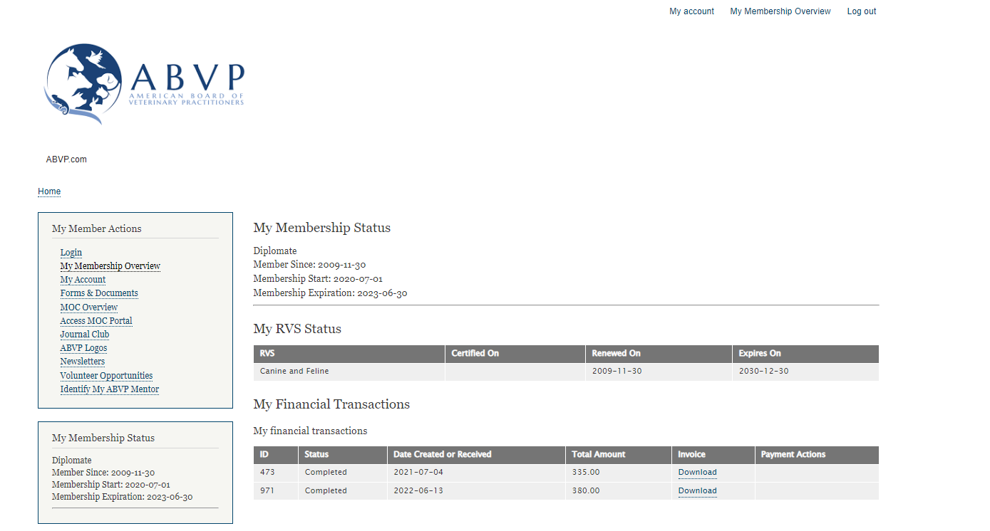
My Membership Overview
Dues information is here.

Slide 8
My Membership Overview
Next, the MOC stuff…

Slide 9
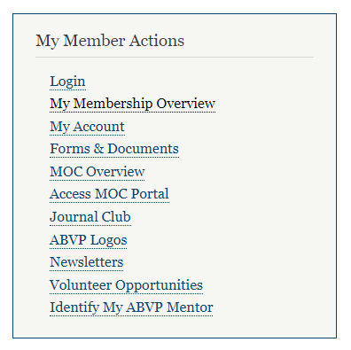
Getting Around
Web page with info and examples

Slide 10
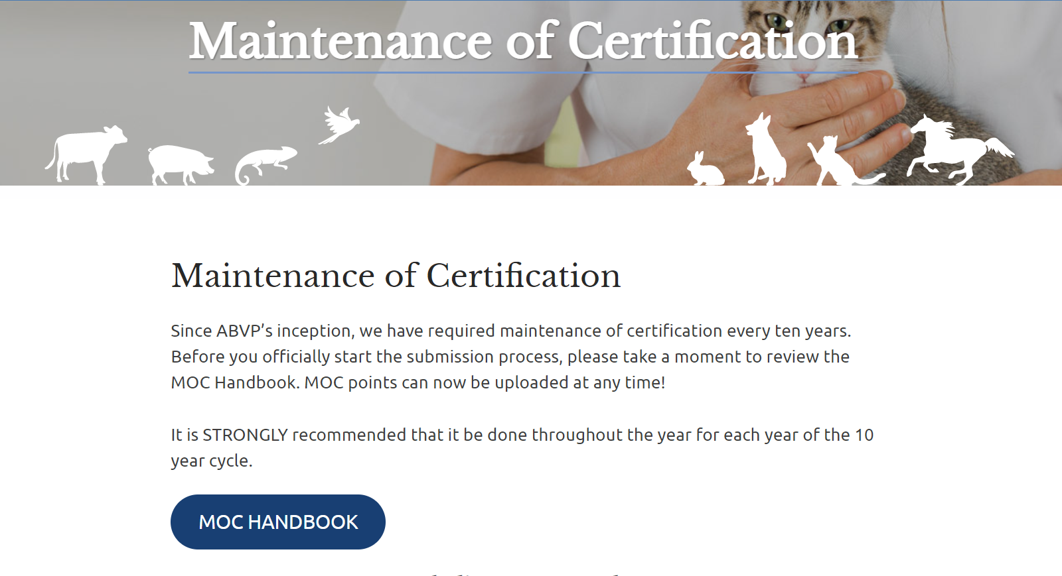
HANDBOOK
https://abvp.com/maintenance-certification-plan/
Do NOT download.
MOC Committee works very hard to keep examples fresh based on FAQs.
:)

Slide 12
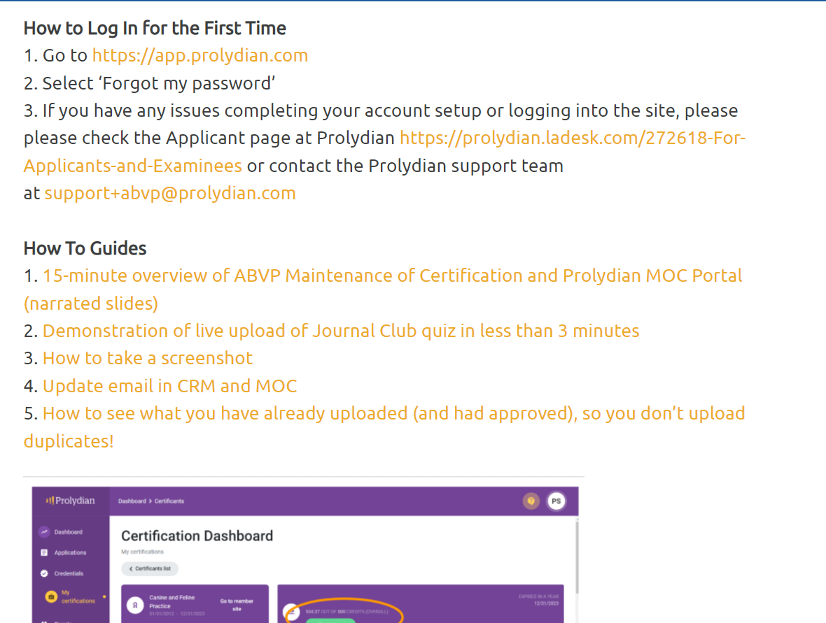
Scroll down for…
Examples, how-tos, videos and stuff…

Slide 13
Getting Around
All old and new JCs

Slide 14
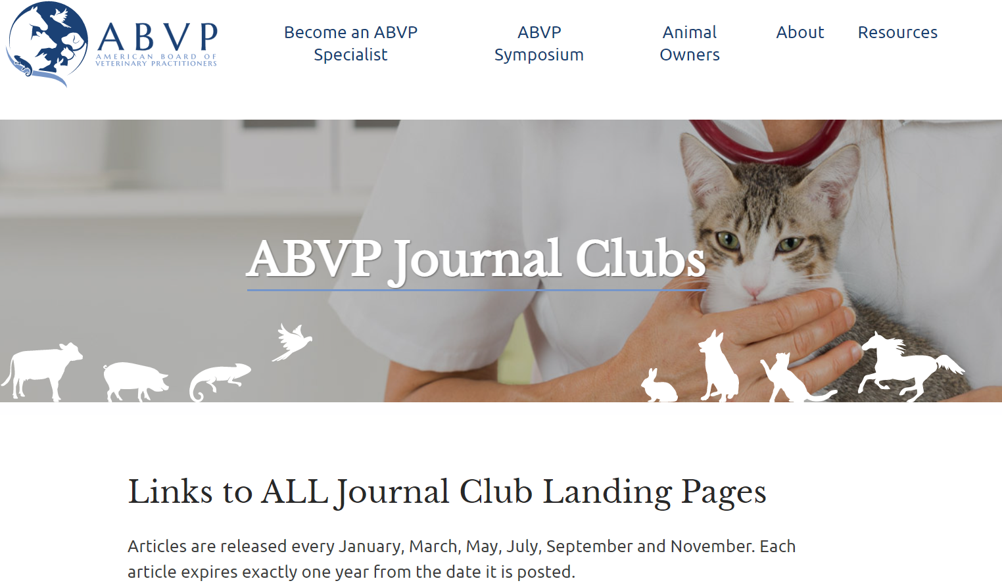
Journal Club

Slide 15
Getting Around
Prolydian purple world

Slide 16
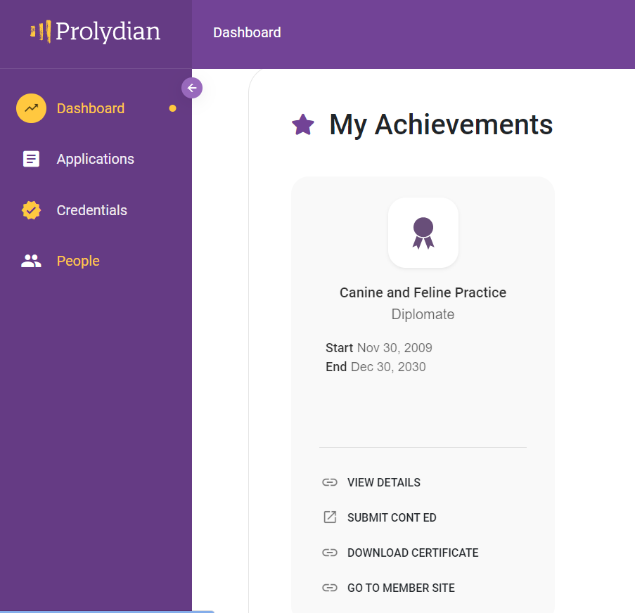
MOC Portal
Purple World !
You will need to log in again to see this screen.
We recommend that you use the same email and password as your diplomate portal.

Slide 17
Important!
Member
Portal
(white world)
MOC
Portal
(purple world)
NO communication!!!
so…

Slide 18
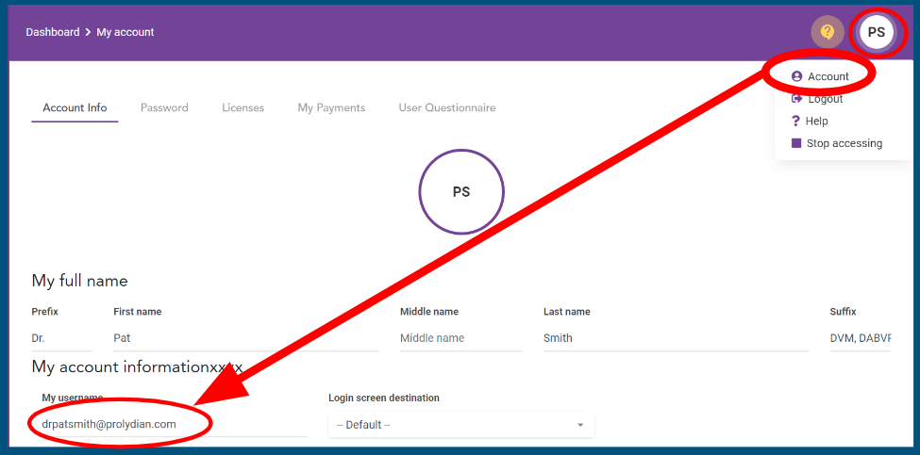
Keep your email updated in your MOC Portal, also!

Slide 19
Speak Prolydian (It’s in the handbook.)
Prolydian Terminology | ABVP Equivalent
CEC credit (continuing education credit) | MOC Point
My Achievements | My Diplomate Status
Applications | MOC point requests for review
Certificant | Diplomate
Category | One of the three broad categories needed to MOC. Additional MOC Points Journal Club Required CE per 10 year MOC cycle
Activity | Specific items within each Category
Submit Cont Ed | Start an Application for Points
Notes:
CEC credit is redundant.

Slide 20
MOC Portal
Purple World !
To get to your Dashboard, click on View Details.
or…

Slide 21
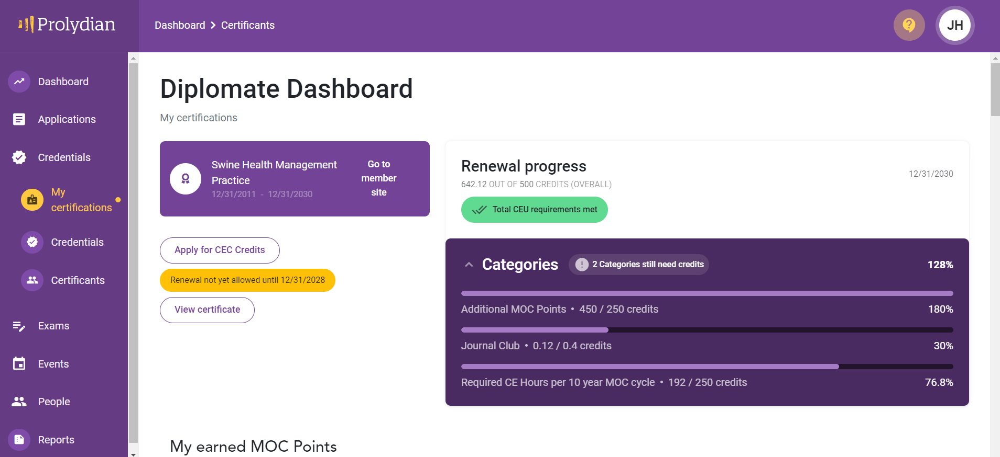
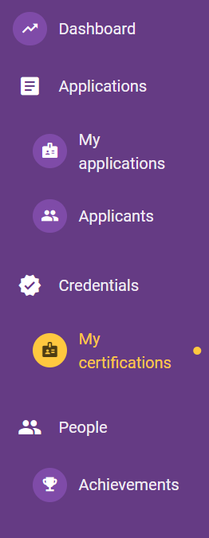
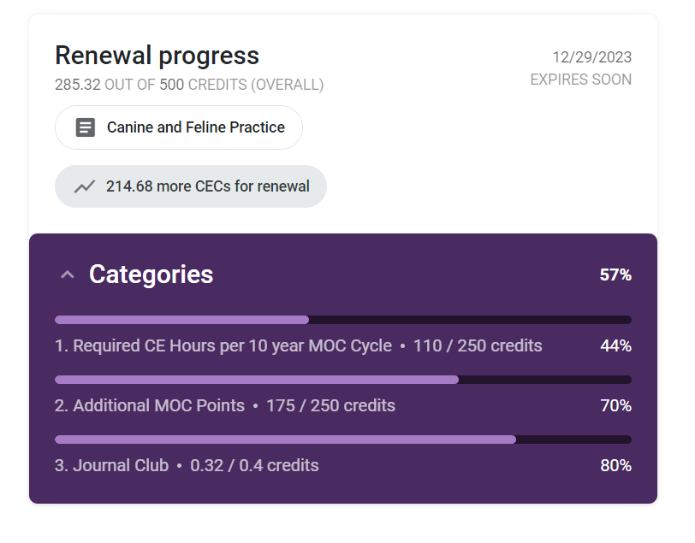
Getting to the Diplomate Dashboard
Click
Credentials
Then
My Certifications

Slide 22
Categories
How many more points do I need?
All Transition Points have already been applied.
Just “fill” up to 100%.
Notes:
JC (0.01 points x 40 = 0.4)

Slide 23
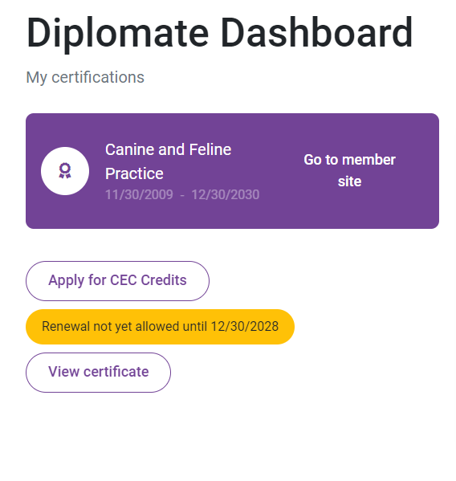
Apply for points from either
Submit Cont Ed
and
Apply for CEC Credits
same as
Request
MOC Points

Slide 24
Need Help?

Slide 25
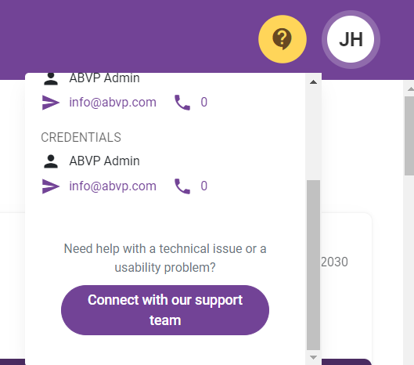
Click the ?- !
Connect with Prolydian Support!
Instant chat even most weekends
or
email dedicated support line
support+abvp@prolydian.com
or
mocchair@abvp.com

Slide 26
MOC
Next up:
Examples of applying for points

