Slide 1
MOC Handbook
Sonnya Dennis, DVM, DABVP (Canine and Feline)
ABVP Maintenance of Certification Committee Chair
Last update 4/1/23

Slide 2
This is a SUMMARY!
See the MOC Handbook
for details.

Slide 3
Diplomate Requirements
All ABVP Diplomates are required to maintain certification every 10 years.
You are responsible for being aware of and keeping track of this.
Mandated by the AVMA American Board of Veterinary Specialties.
No exceptions can or will be made. We are bound by AVMA’s ABVS for RVSOs and RVSs bylaws, ethics, and rules on eligibility.
Extensions will not be granted for claims of lack of notification.
Read the handbook for details.

Slide 4
What if I don’t MOC?
No extensions! The deadline has already moved from January 15th to July 15th.
If the Diplomate has not fulfilled the requirements by year 10,
Diplomate status will be revoked.
Diplomate title must be removed immediately from all marketing and business materials.
No Time-Stamped Certification. e.g. Pat Smith, DABVP (Feline 2010-2020) is not allowed.
Consider Emeritus.
Process for re-certification.

Slide 5
Maintain vs Re-Certify
MOC is an ongoing process.
Begin submitting as soon as certification is granted for the next cycle.
MOC Vice Chairs to review points applications ongoing basis.
All material is due July 15th of the year you expire.
Once all MOC Points Applications have been approved, you will start a separate renewal application and upload your license.

Slide 6
Appeals
There is an official appeals process in the event of rejection of applications, only on the grounds that the decision:
Disregarded the established criteria for certification or approval,
Failed to follow ABVP stated procedures,
Failed to consider relevant evidence and documentation presented.
Please contact the MOC Chair first, if you think an application was wrongly rejected by your RVS Vice Chair!

Slide 7
Maintenance of Certification Pathway
is by accumulation of points, and developed to be consistent with ABVP’s core values.

Slide 8
Maintenance of Certification Pathway
Four (4) Requirements Every 10 Years To Maintain Certification.
Diplomates must
Acquire 250 hours of continuing education over a 10 year period.

Slide 9
Maintenance of Certification Pathway
Four (4) Requirements Every 10 Years To Maintain Certification.
Diplomates must
Acquire 250 hours of continuing education over a 10 year period.
Acquire an Additional 250 points by any of the specified activities.

Slide 10
Maintenance of Certification Pathway
Four (4) Requirements Every 10 Years To Maintain Certification.
Diplomates must
Acquire 250 hours of continuing education over a 10 year period.
Acquire an Additional 250 points by any of the specified activities.
Complete 66% of presented journal club articles over the 10 year MOC period (an average of four (4) of six (6) journal articles per year)

Slide 11
Maintenance of Certification Pathway
Four (4) Requirements Every 10 Years To Maintain Certification.
Diplomates must
Acquire 250 hours of continuing education over a 10 year period.
Acquire an Additional 250 points by any of the specified activities.
Complete 66% of presented journal club articles over the 10 year MOC period (an average of four (4) of six (6) journal articles per year)
Document a valid veterinary license.

Slide 12
Maintenance of Certification Pathway
Four (4) Requirements Every 10 Years To Maintain Certification.
Diplomates must
Required Continuing Education 250 hours
Additional Points 250 points
Journal Club 40 quizzes
License

Slide 13
Maintenance of Certification Pathway
Three (3) Category Requirements Every 10 Years To Maintain Certification.
Diplomates must
Acquire 250 hours of continuing education over a 10 year period.
…
…

Slide 14
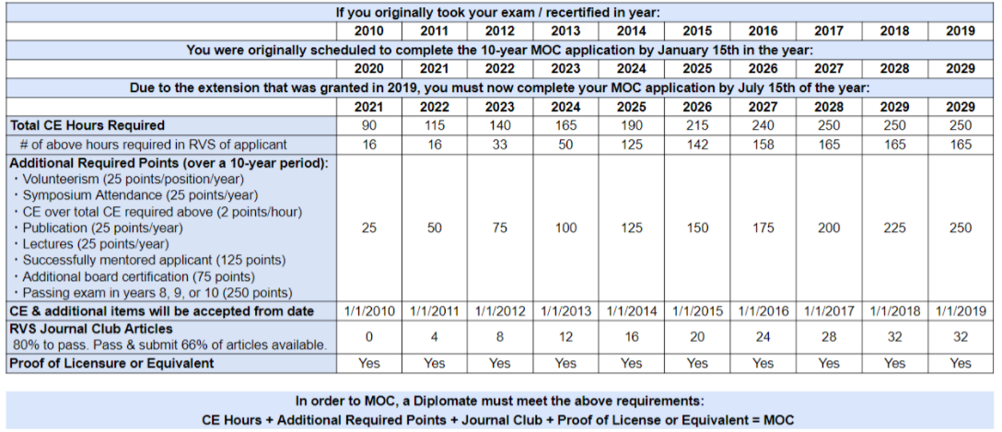
MOC Transition Chart
A 1 year extension on your original expiration date and transition points for each category have ALREADY BEEN APPLIED to your account due to the change in MOC rules.

Slide 15
MOC Transition Points
Your points will look something like this once you log in and be EXTENSIVELY COVERED in the next slide presentation.

Slide 16
250 points
Required Continuing Education
Average 25 hours of CE per year.
Minimum of 165 hours must be within the RVS (66% of 250 total).
Remaining 85 points may be in any category.
Lectures in the “Cross species track” at the ABVP Symposium are accepted for RVS hours.

Slide 17
250 points
Required Continuing Education
Upload CE Certificates.
Hours may be audited.
Retain proof of CE until after MOC is complete and final confirmation is received.
This means 10 years!
If a multiple day conference is uploaded, upload a separate list of lectures attended.
If both RVS and NON-RVS lectures were attended in the same conference
Upload one with the RVS lecture list and points.
Upload a separate one with the NON-RVS lecture list and points.

Slide 18
Maintenance of Certification Pathway
Three (3) Category Requirements Every 10 Years To Maintain Certification.
Diplomates must
…
Acquire an Additional 250 points by any of the specified activities.
…

Slide 19
250 Additional Points
Possible Activities to accumulate Additional Points
ABVP Volunteerism
ABVP Symposium attendance
Publication in peer reviewed journals
Lectures given
Additional Continuing Education
Successfully mentored ABVP applicant
Second specialty board certification
Passing the exam

Slide 20
250 Additional Points
ABVP Volunteerism
25 points per year per committee
Appeals
Credentials
DEI
Exam
Leadership Development
Maintenance of Certification
Outreach
Residency
Board of Directors or RVS Regent
ABVS Representative
Complete the Volunteer Form if you are interested in volunteering!!!

Slide 21
250 Additional Points
ABVP Symposium attendance
25 points per year.
These points are in addition to any points submitted for actual lectures attended!
Uploading Certificate.

Slide 22
250 Additional Points
Publication in peer reviewed journals
25 points per publication.
Guidelines are acceptable if published in a peer reviewed journal.
First authorship is not required.
Letters to the editor are not acceptable.
Book chapters are not acceptable.

Slide 23
250 Additional Points
Lectures given
25 points per year.
Audience
YES: veterinarians, veterinary students, veterinary technicians, or technician students.
NO: non-medical audiences such as breeders, farriers, etc.
The same lecture may not be submitted every year for 10 years.
1 Lecture = 25 points.
A total of 250 points over a 10 year period.

Slide 24
250 Additional Points
Continuing Education over the Required 250 points
2 points per hour.
No limit to additional hours submitted.
Can be in any RVS.

Slide 25
250 Additional Points
Successfully mentored ABVP applicant
125 points.
Mentee must fill out form to identify and credit their mentor.
Only after the mentee finishes the credentialing process and successfully passes the exam.
The mentee can only identify one diplomate as their mentor (no splitting points).

Slide 26
250 Additional Points
Second specialty board certification
75 points.
Specialty boards are those recognized by the AVMA ABVS.
This applies only to new board certification.

Slide 27
250 Additional Points
Passing the exam in year 8, 9, or 10
250 points.
Passing the exam in one of these years ONLY provides points.
You can no longer MOC by ONLY passing the exam!
You MUST also have all continuing education and journal club.
Notes:
Year 10 us past the deadline, so you need to notify the MOC Chair.

Slide 28
Maintenance of Certification Pathway
Three (3) Category Requirements Every 10 Years To Maintain Certification.
Diplomates must
…
…
Complete 66% of presented journal club articles over the 10 year MOC period (an average of four (4) of six (6) journal articles per year)

Slide 29
250 Additional Points
6 articles will be presented each year.
A score of 80% is required to receive credit.
Diplomates may take the quiz up to three (3) times.
KEEP UP! The quiz is only available for 1 year after posting.
Since this is separate from the 500 points required for maintenance of certification, quizzes are assigned a 0.01 value as a placeholder.

Slide 30
Journal Club Quizzes
Email sent out to notify of new JC posting.
Access articles via the link after member login.
Follow the instructions carefully on the quiz. A saved screenshot of proof of passing grade will be required when entering the application in the portal.

Slide 31
Maintenance of Certification Pathway
Four (4) Requirements Every 10 Years To Maintain Certification.
Diplomates must
…
…
…
Document a valid veterinary license.

Slide 32
License
AFTER ALL 3 Categories are complete (CE + Additional + JC)
Year 9 or 10 of your cycle
Start the renewal application
If not required to maintain a valid license for current employment, documentation attesting to this is required.

Slide 33
WARNING!
You may enter items at any point during the 10 year MOC period, starting immediately after you complete initial credentialing or MOC.
Do not wait to upload all items in your final year!
It is STRONGLY RECOMMENDED to upload items at least YEARLY.
NO EXTENSIONS WILL BE GRANTED!
Vice Chairs are there to help you! Make friends with your VC!

Slide 34
Maintenance of Certification
Committee 2023-2024
Sonnya Dennis, Chair mocchair@abvp.com
Anthony Pilny, Avian avianmoc@abvp.com
JoLynn Grant (A-L) & Ellen Olson (M-Z), Canine/Feline caninefelinemoc@abvp.com
Amy Santonastaso, Equine equinemoc@abvp.com
Hilary Stern, Exotic Companion Animal ecmmoc@abvp.com
Rachel Seder, Feline felinemoc@abvp.com
Dan Posey, Food, Beef, and Dairy foodbeefdairymoc@abvp.com
Heather Bjornebo, Reptile/Amphibian ramoc@abvp.com
Uri Donnett, Shelter sheltermoc@abvp.com
Lisa Tokach, Swine swinemoc@abvp.com

Slide 35
MOC
Next up, Prolydian
(the mechanics)

